Slide 1
Advanced Chi-Squares in R

Slide 2
Differentiating Between Categorical Statistics
Test | Comparing… | Con’t Equivalent
One Proportion | Specific component to the whole
Two Proportion | Ratio of one component to another to the ratio for the whole
Goodness-of-fit Chi-Square | Frequencies of a single variable in sample to a population | Single sample t-test
Independent Chi-Square | Frequencies of two unrelated variables | Independent t-test
McNemar Chi-Square | Frequencies of two related variables with 2 levels | Dependent t-test
Bhapkar Chi-Square | Frequencies of two related variables with 2+ levels | Repeated measures ANOVA

Slide 3
The Library
library(“gmodels”)

Slide 4
Assumptions for Chi-Squares
At least 5 expected values per cell

Slide 5
Independent / McNemar Code
CrossTable(dataFrame$col, dataFrame$col, chisq=TRUE, expected=TRUE, sresid=TRUE, format=“SPSS”)
chisq=TRUE gives you the chi-square statistic and associated p-value
expected=TRUE gives the expected values to test for the assumption
sresid=TRUE gives the standardized residuals
format=“SPSS” provides easy-to-read formatting

Slide 6
Goodness-of-Fit Code
You’ll need the frequencies for each category (can summarize with dplyr)
observed = c(#, #)
expected = c(p, p)
chisq.test(x=observed, p = expected)

Slide 7
What are Standardized Residuals?
Type of post hoc
Tells you what categories specially differ overall
What contributes the most to the significant Chi-Square statistic?
If ± 2, then that category is significantly different
+ greater than
- less than

Slide 8


Interpreting Output
Scroll to the bottom first!
p value should be < .05 before you look at anything else

Slide 9
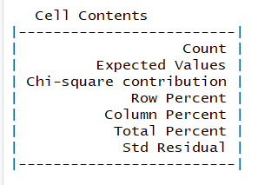
Interpreting Output
The order the numbers go in

Slide 10
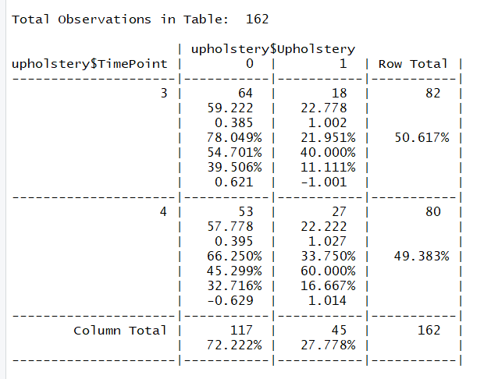
Interpreting Output
Look at row 2 first:
> 5 to meet assumptions

Slide 11
Interpreting Output
Then examine bottom row:
Anything > ± 2 is sig. different

